Slide 1
Year 6 Maths Summer Project – Park Design
You have been tasked with designing a new park for the local community
Requirements of your park design:
It must cater for the communities in as many ways as possible with the features you add, it is okay to have more than one feature which caters to a community.
Around 1/3 of your park must remain empty with just grass (this is 200 squares of the space).
Your budget is: £500,000
You may want to think about your placement of each of the features in the layout and design plan of your park (for example, if you are putting in a concession stand and toilets, would It make sense to put these close together or far apart? If you are adding paving, where do you want this paving leading to?).
You will have the opportunity, only if you want to, to present your plan to your class when you arrive in September.

Slide 2
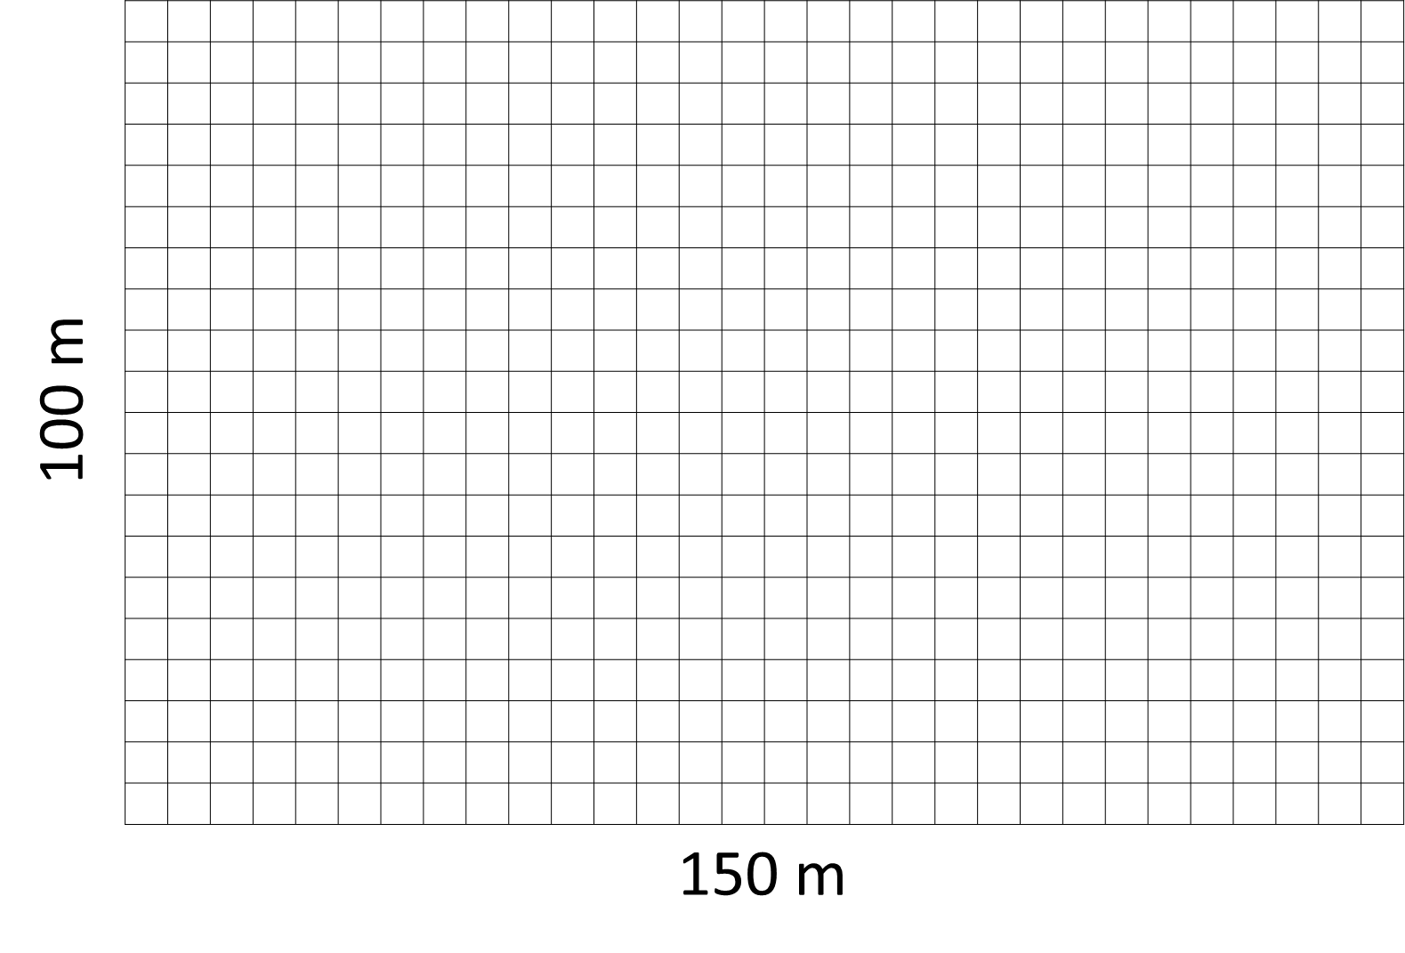
In your first week at Mossley Hollins you must bring:
An A3/A4 map of the design of your park.
A breakdown of your budget (how much you spent, and what on) and a breakdown of how much area of the park these features have taken up (do you still have the 1/3 of the park free to just be grass like asked in the brief?)
Example;
Placing a football pitch (5 by 10 squares)
Steps to complete the task;
Choose which features you want to add into your park (you can choose things more than once)
Fill in the budget sheet, working out how much you have spent, being careful not to go over your £500,000 budget.
Place all your features on the park to create a useable, interesting park for the community.
Football Pitch

Slide 3
Park Template
100 m
150 m

Slide 4
Features to chose from:

Slide 5
Feature | Quantity Purchased | Amount Spent | Area Covered | Communities Served
Total spent:
Total area:

