Slide 1
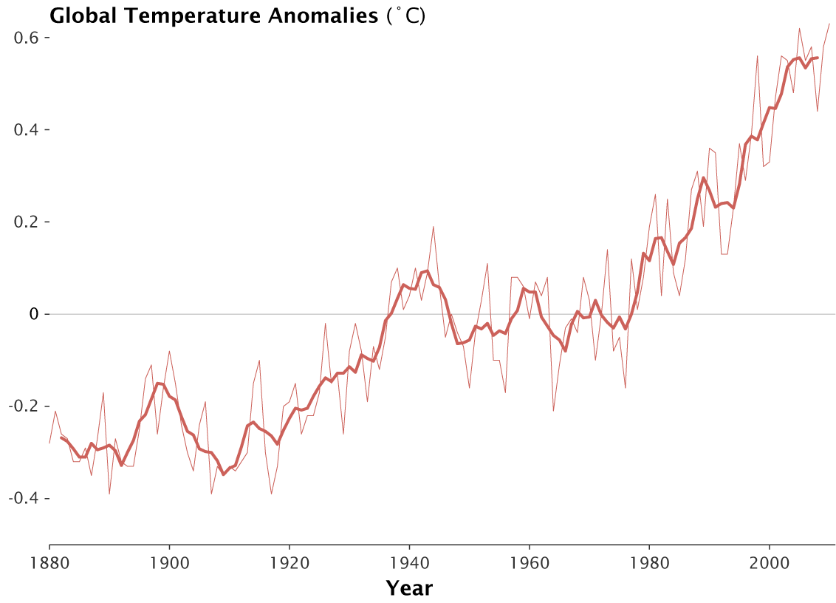
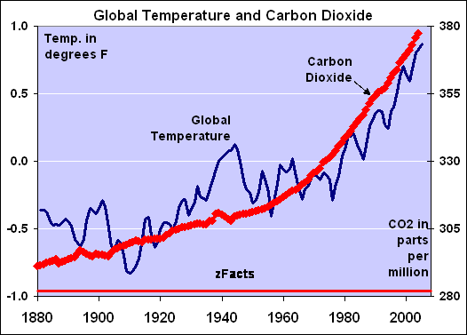
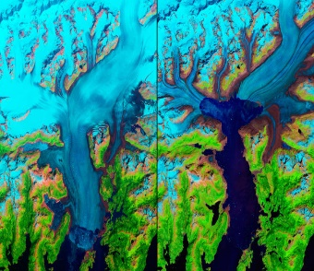
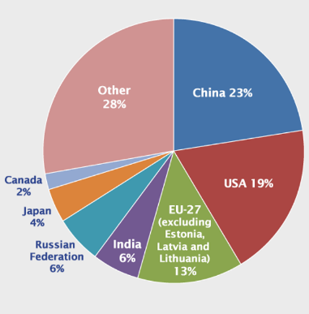
What is Climate Change?
Climate change is a large-scale, long-term shift in the planet's weather patterns or average temperatures. Earth has had tropical climates and ice ages many times in its 4.5 billion years.
Natural Greenhouse Effect
The Earth is kept warm by a natural process called the Greenhouse Effect. As solar radiation hits the Earth, some is reflected back into space. However, greenhouse gases help trap the sun’s radiation. Without this process, the Earth would be too cold to support life as temperature would average as -18°C instead of +15°C.
Linking CO₂ and Global temperatures
The rate of carbon dioxide and increase in global temperatures is strong. Scientist agree that this increase is cause by human activity.
Quaternary geological period
The quaternary period is the last 2.6 million years. During this period temperatures have always fluctuated. The cold ‘spikes’ are the glacial periods, whereas the warm points are the interglacial periods.
Today’s temperature is higher than the rest of the period. Despite alternate cold and warm moments within this period, global temperatures have increased above average in the past 100 years. This current trend is what's become know as global warming.
Enhanced Greenhouse Effect
Recently, there has been an increase in humans burning fossil fuels for energy. These fuels (gas, coal and oil) emit extra greenhouse gases. This is making the Earth’s atmosphere thicker, therefore trapping more solar radiation but causing less to be reflected. As a result, our Earth is becoming warmer.
Evidence for climate change
Earth’s temperature has changed over the last 2.6 million years. Scientist know this by collecting a range of evidence that is trapped or stored in the environment around us.
Geological fossil evidence | Plants and animals fossils/remains which favour certain environmental conditions have been found in contractionary conditions, thus suggesting periods of a warmer and colder time. E.g. Mastodon in USA.
Ocean Sediment | Layers of sediment that has built up over time have provided scientist trapped oxygen isotopes. Scientist have used them to calculate and understand that atmospheric temperature have indeed changed.
Ice Cores | Ice cores are made up from different layers that each represents a different historical time. By exploring the water molecules of these cores, scientist have calculated fluctuating temperatures of the atmosphere.
Historical records | Historical records from ancient cave paintings, diaries and written observations have provide evidence of climate change through personal accounts from the people through them.
Retreat of the Columbia Glacier, Alaska, USA
Located in southern Alaska, it flows 50km to the sea. The glaciers has been retreated by 16km and has lost half of its thickness in the last 30 years. Scientist believed this is due to global warming, which if continued will contribute towards continued sea level rises.
Greenhouse Gases
Most greenhouse gases occur naturally. Some greenhouse gases have greater potential to increase global warming than occurs as different gases trap and absorb different amounts of radiation.
Carbon dioxide | Accounts for 60% of the enhanced greenhouse gases. It is produced by burning fossil fuels through producing electricity, industry, cars and deforestation.
Methane | Accounts for 15% of the enhanced greenhouse gases. 25x more efficient than Carbon dioxide. Produce from landfills, rice and farm animals.
Halocarbons | Human made and makes a tidy proportion of all greenhouse gases. 15000x more efficient at trapping radiation than Carbon dioxide. Produced from air-conditioning, refrigerators and aerosols.
Nitrous Oxide | Accounts for 6% of the enhanced greenhouse effect. 250x more efficient than Carbon dioxide. Produced from fertilisers and car exhausts.
Topic 2
CHANGING CLIMATE
Past Evidence: The Little Ice Age (1300-1870)
The Little Ice Age was a period of cooling that occurred after the Medieval Warm Period in parts of Europe and North America. Impacts included…
1. Price of grain increased and vineyards become unproductive.
2. Sea ice engulfed Iceland and the sea force around parts f the UK. Frost Fairs were held on rivers such as the River Thames.
3. People suffered from the intense cold winters as food stock were limited.
Whose responsible?
LIDCs | Countries in Africa, such as Kenya, emit low levels of carbon dioxide. This is due to these countries not being industrialised or having a population wealthy enough to consume lots of energy
EDCs | Countries such as China and India are increasingly more industrialised and therefore are emitting more carbon dioxide. These increasing population sizes and steadily increasing wealth mean more energy is being consumed.
ACs | Countries such as the USA and UK are industrialised with a wealthier population that enjoy lifestyles which required a large consumption of energy.
Recent Evidence for climate change.
In the past 100 years, scientists have become pretty good at collecting accurate measurements from around the world. These measurements have suggested a trend that the climate is yet again changing.
Global temperature data | Evidence collected by NASA suggests average global temperatures have increased by more than 0.6°C since 1950.
Ice sheets and glaciers | Evidence from maps and photos have shown many of the world’s glaciers and ice sheets are melting. E.g. the Arctic sea ice has declined by 10% in 30 years.
Sea Level Change | Evidence from the IPCC has shown that the average global sea level has risen by 10-20cms in the past 100 years. This is due to the additional water from fresh water ice and thermal expansion of the ocean due to higher temperatures.
Evidence of natural change
Climate change has occurred in the past without human ever being present. This suggests that there are natural reasons for the climate to change.
Milankovitch cycle | Milutin Milankovitch argued that climate change was linked to the way the Earth orbits the Sun, and how it wobbles and tilts as it does it. There are three ideas that are thought to change climate.
 | 1. Eccentricity: Changes in the shape of Earth’s orbit.
 | 2. Obliquity: Changes in how the Earth tilts on its axis.
 | 3. Precession: The amount the Earth wobbles on its axis.
Sun Spots | Dark spots on the Sun are called Sun spots. They increase the amount of energy Earth receives from the Sun.
Volcanic Eruptions | Volcanoes release large amounts of dust containing gases. These can block out sunlight and results in cooler global temperatures.
Not what is seems
Although China is responsible for the highest amount of carbon emission, 1.4 billion people do live there. However, per person, the USA (320 million) actually contributes far more CO₂ emissions.

Slide 2
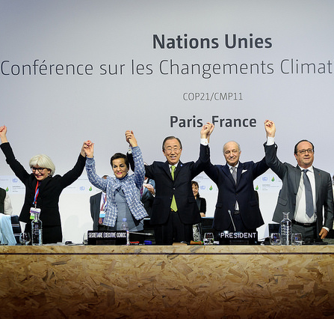
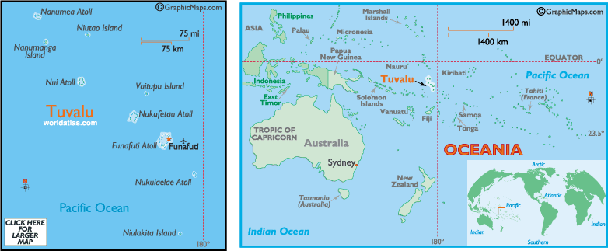
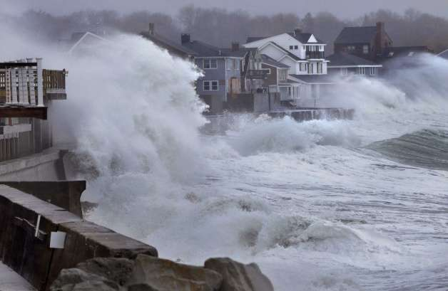
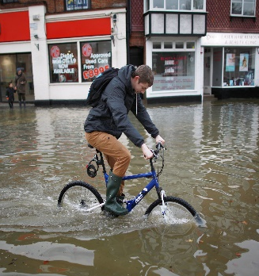
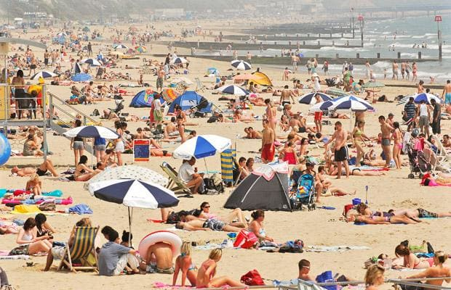
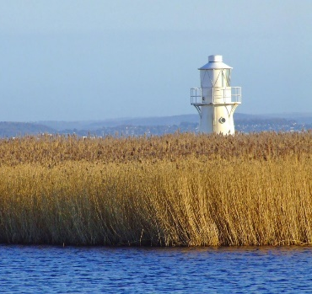
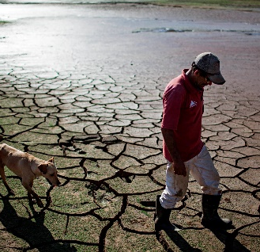
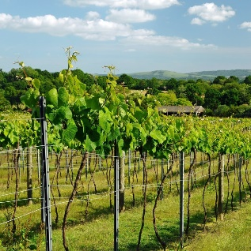
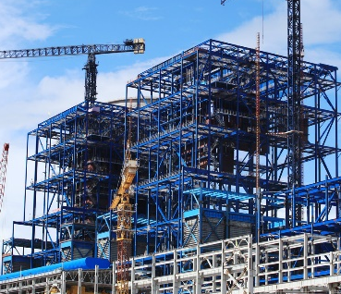
Global impacts of climate change
The impact of rising temperatures (up to 4.8degrees by 2100) is affecting the world socially, economically and environmentally in several ways.
Extreme Weather | Climate is causing more unpredictable and severe weather events. This includes more frequent and powerful tropical storms; more extreme heatwaves and lasting droughts. E.g. Typhoon Haiyan 2013
Rising sea levels | Sea levels have risen by 20 cm since 1901. due to thermal expansion, melting glaciers and ice caps. 600 million people live <10m sea level. Locations including Tuvalu will be at risk of flooding.
Food supply | Warmer temperatures and changing rainfall will make it harder to produce a reliable source of food to sustain a rising global population. E.g. In 2011, Russia banned crop exports after a incline in yield.
Plants and Animals | About a quarter of animals and plants on Earth could become extinct. With warmer temperatures and changing rainfall environments will no longer be able to provide for the world’s fragile ecosystems.
Disease and Health | Warmer temperatures will increase the spread of infectious diseases like malaria. In addition, more frequent floods could cause more waterborne disease such as dysentery.
Water Supply | People need freshwater to drink but with 1 billion people predicted to not have excess to enough water by 2025 due to climate change, this might cause several social, economic and environmental problems. E.g. fishing, sanitation, wildfires.
Climate refugees | Climate refugees are people who are forced to leave their home due to the impact of climate change. This can be due to sea level rises or extreme weather conditions such as drought. E.g. Venice
Rising Sea Levels: Tuvalu
Tuvalu is a group of tiny islands in the South Pacific. Most islands are low-lying with the highest point being 4.5m above sea level. Population is 11,000 people and the economy relies mainly from exporting copra.
Impacts from climate change
Social | Economic | Environmental
- Water supply due to droughts becoming more common. - Wells are becoming polluted by seawater. - High tides are starting to threaten homes and roads. | - Increased levels of salinization affecting soil for agriculture. - Coastal erosion is destroying productive farmland. - Main runway threaten by flooding. | - Ocean acidification is reducing fish stocks around the island. - Warmer temperatures are destroying fragile ecosystems such as coral reefs.
Management
Campaigning internationally for a reduction in carbon emissions. Migration to safer islands off the coast of New Zealand. Low sea walls have been constructed to prevent erosion and flooding. Japan supporting coral reef restoration by introducing new species to damaged reefs.
Climate change management: Paris Agreement 2015
Paris climate conference involved 195 countries making a legally binding global climate deal. This agreement objective is to limit global warming to below 2°C. The aims of this objective are… Limit emissions to pre-industrial levels. Meet every 5 years to set new targets. Communicate plans to the public. Provide support to developing countries at reducing emissions.
Extreme Weather: Brazilian Drought 2014
Brazil is a EDC in the continent of South America. Its population is 204 million. In 2014 it faced a record breaking dry season that resulted in serve drought conditions. Scientist believe that deforestation may have contributed in changing the climate.
Impacts from climate change
Social | Economic | Environmental
Drought caused a reduction in the production of hydroelectric power. Major cities faced water shortages. | Shortage of water affected industrial production. Coffee industry was severely affected due to the lack of rainfall. | As reservoir levels dropped, levels of pollution increased. This damaged natural ecosystems and killed fish.
Management
Introduction of water rationing and recycling more water. Repair leaking pipes to decrease water waste. Introduction of more natural gas to sustain energy demands.
Impacts of climate change on the UK.
The UK’s climate is also changing. It is expected to… Increase in average temperature. Have warmer, but wetter winters. Have warmer and drier summers. However, not all the impacts to the UK will be negative, there are clear benefits for a changing climate.
Negative impacts of climate change for the UK
Coastal Flooding |  | Extreme Rainfall
Vulnerable low lying areas could flood homes and infrastructure. £120 billion worth infrastructure at risk.. Damage to the economy. |  | Increase in extreme flash floods. Flood damage to homes and businesses. Soil contaminations on farmland. By 2080, 1 million properties will be at risk of flooding.
Water Shortages |  | Extreme Heat
Farmers will find it difficult to irrigate land. Water restrictions, with London being worst affected. |  | Warmer weather can increase health problems especially for the elderly. Infectious diseases such as malaria might spread.
Positive impacts of climate change for the UK
Tourism |  | Environment
More people likely to take holidays within the UK. E.g. Lake District The economy could be boosted: helping to create new jobs. More outdoor events could become common. |  | New wetlands from coastal flooding could become established. New wildlife and plants could be drawn to the UK. Managed retreat will create new salt marsh habitats.
Farming |  | Industry
Agriculture productivity may increase under warmer conditions. Farmers could potentially grow new foods used to warmer climates. E.g. Soya, Wine. |  | Heating costs could fall. Construction industry will be boosted by the need to build sea defences. New designs produced to cope with conditions.

